Slide 1

Soil nitrogen availability modifies leaf water and nitrogen economies in a closed canopy temperate forest: a direct test of photosynthetic least-cost theory
Evan A. Perkowski¹; David W. Frey²; Christine L. Goodale²; Nicholas G. Smith¹
¹Dept. of Biological Sciences, Texas Tech University
²Dept. of Ecology and Evolutionary Biology, Cornell University

Slide 2
Leaf nitrogen is a common surrogate for leaf-level photosynthetic capacity
Evans (1989) Oecologia

Slide 3
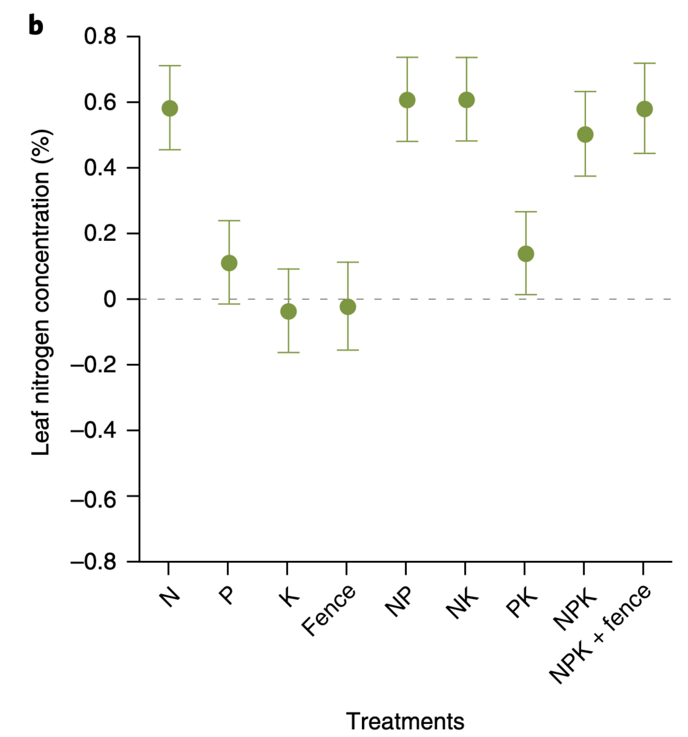
Soil nitrogen has been shown to increase leaf nitrogen
Firn et al. (2019) Nature

Slide 4
Soil nitrogen has been shown to increase leaf nitrogen
Plots that receive annual nitrogen inputs generally have higher leaf nitrogen content
Firn et al. (2019) Nature

Slide 5
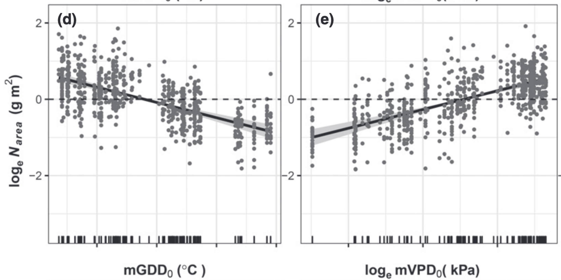
However, leaf nitrogen can also be predicted independent of soil nitrogen
mGDD₀ = mean annual temperature
mVPD₀ = mean vapor pressure deficit
Dong et al. (2020) New Phytologist

Slide 6
Leaf nitrogen is likely a product of plant allocation responses to soil nitrogen and climate

Slide 7
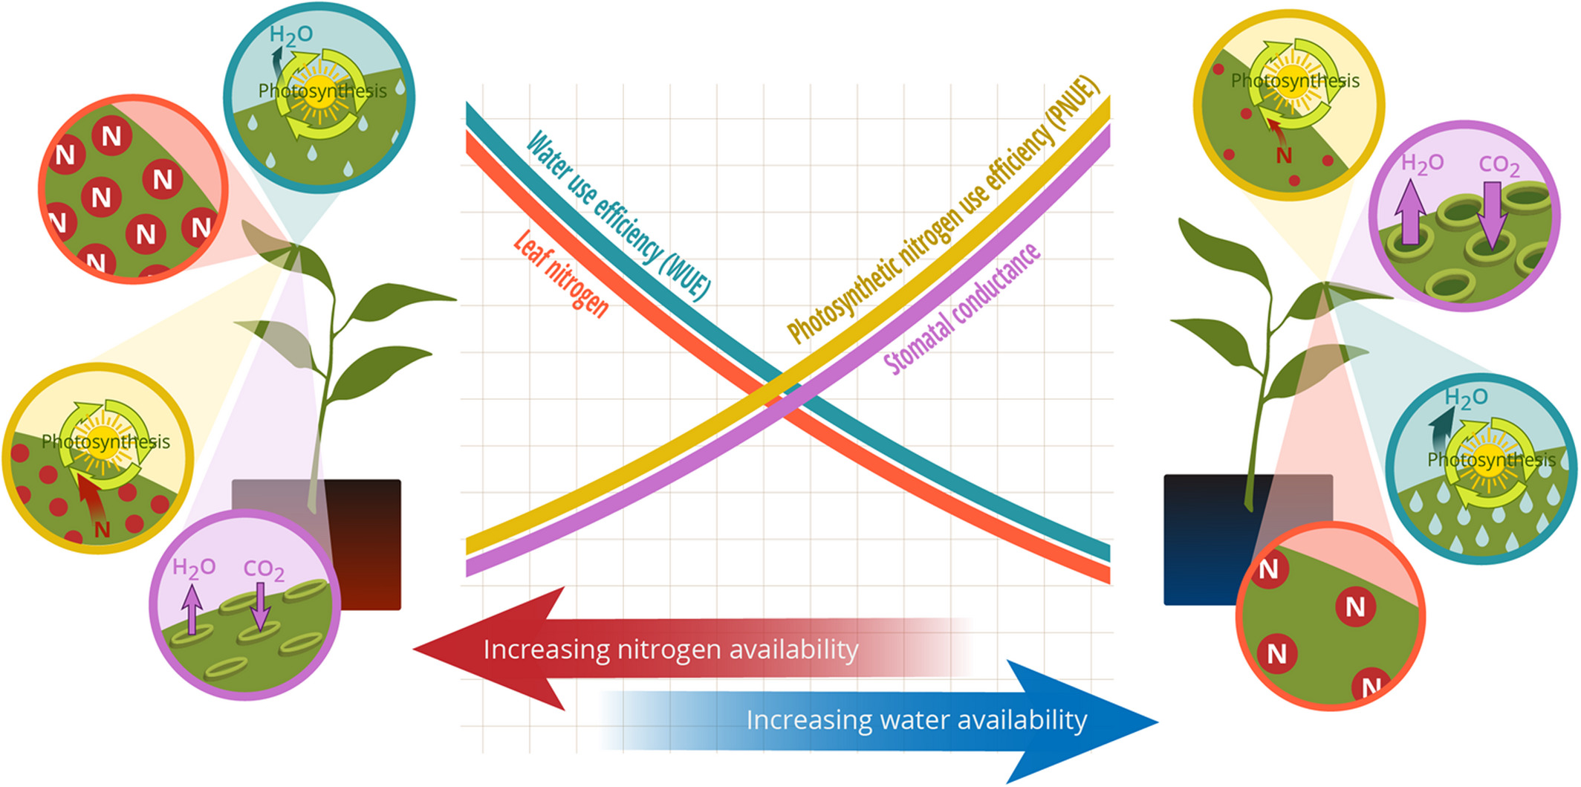
Photosynthetic least-cost theory provides a useful framework for understanding leaf nitrogen allocation responses to climate and soil N
Bialic-Murphy et al. (2021) Ecology Letters
Notes:
Acclimation response is to minimize unit costs of water and nitrogen use by substituting less efficient use of the relatively more abundant resource for more efficient use of the relatively less abundant resource

Slide 8
Photosynthetic least-cost theory provides a useful framework for understanding leaf nitrogen allocation responses to climate and soil N**
**water-nitrogen use tradeoffs may depend on whole plant allocation decisions!
Bialic-Murphy et al. (2021) Ecology Letters

Slide 9
Study Question
How does soil nitrogen availability modify nitrogen-water tradeoffs in a closed canopy temperate forest?
Do nitrogen-water use tradeoff responses to soil nitrogen availability depend on whole plant nutrient allocation decisions?

Slide 10
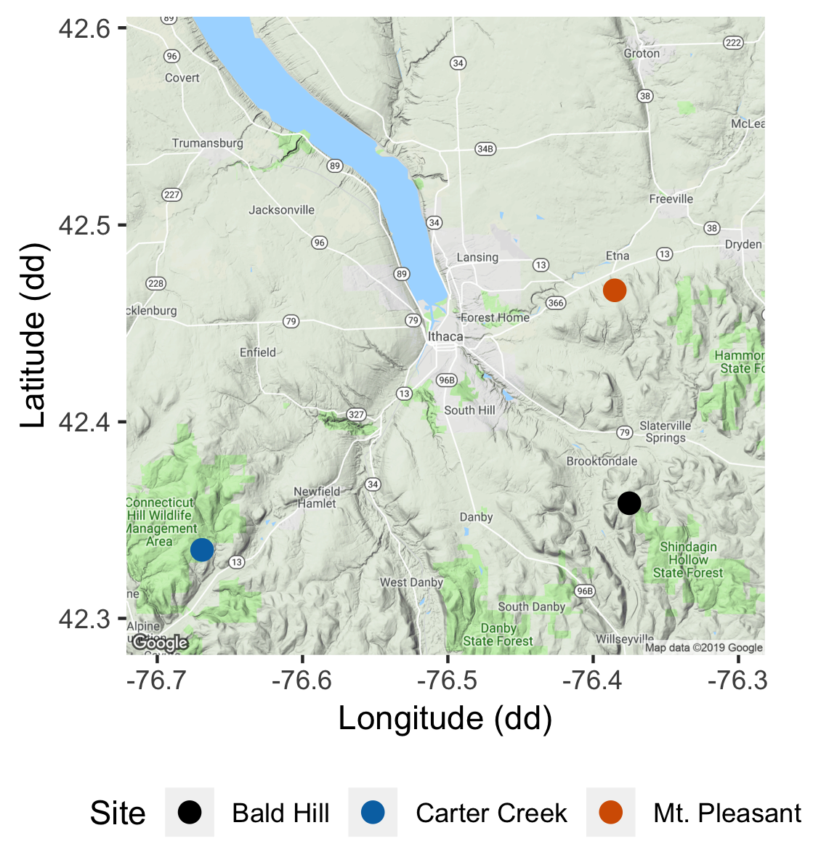
Study system
Soil fertilization treatments
Sites
0 kg ha⁻¹ yr⁻¹ N; 0 kg ha⁻¹ yr⁻¹ S
Bald Hill
0 kg ha⁻¹ yr⁻¹ N;
57 kg ha⁻¹ yr⁻¹ S
Mount Pleasant
50 kg ha⁻¹ yr⁻¹ N;
0 kg ha⁻¹ yr⁻¹ S
Carter Creek
50 kg ha⁻¹ yr⁻¹ N; 57 kg ha⁻¹ yr⁻¹ S

Slide 11


Soil nitrogen availability
RB
RB
RB
RB
RB
Ion exchange resin bag (collects anions/cations over time)
Soil N availability = sum of [NH4-N] and [NO3-N] averaged across all resin bags in plot

Slide 12
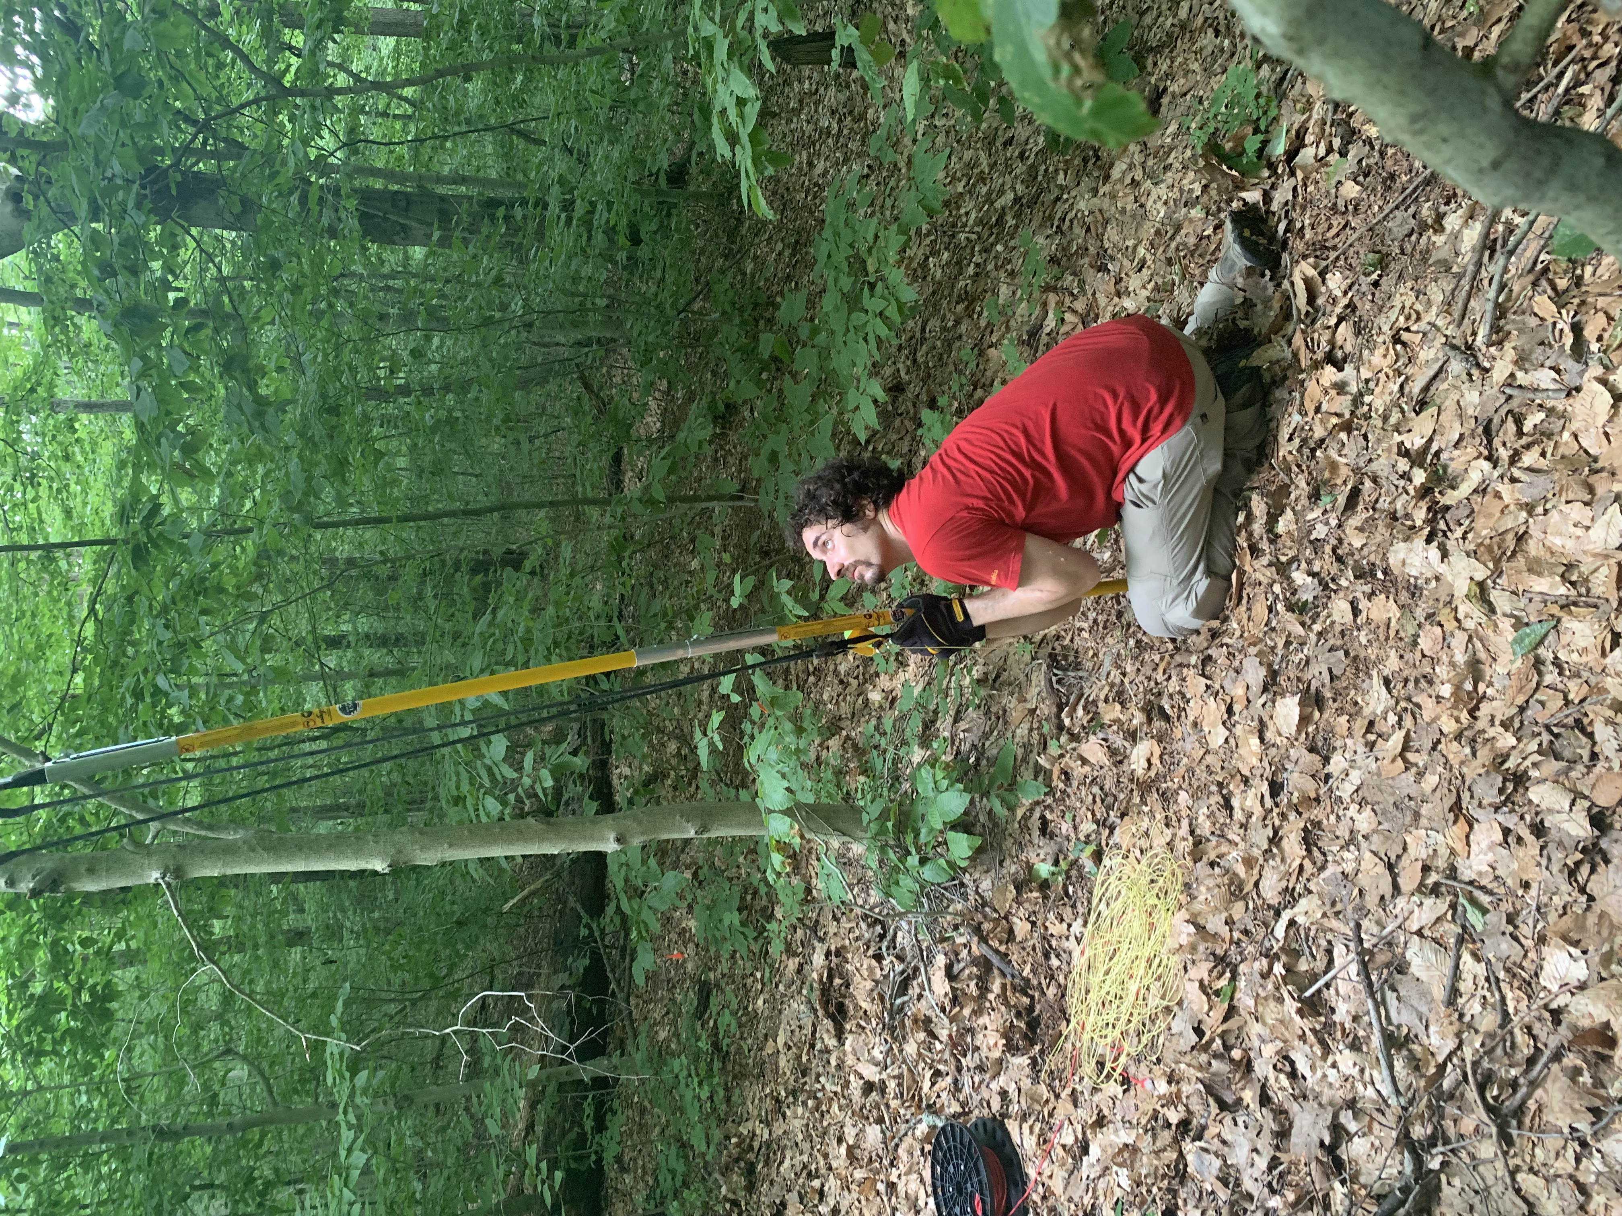
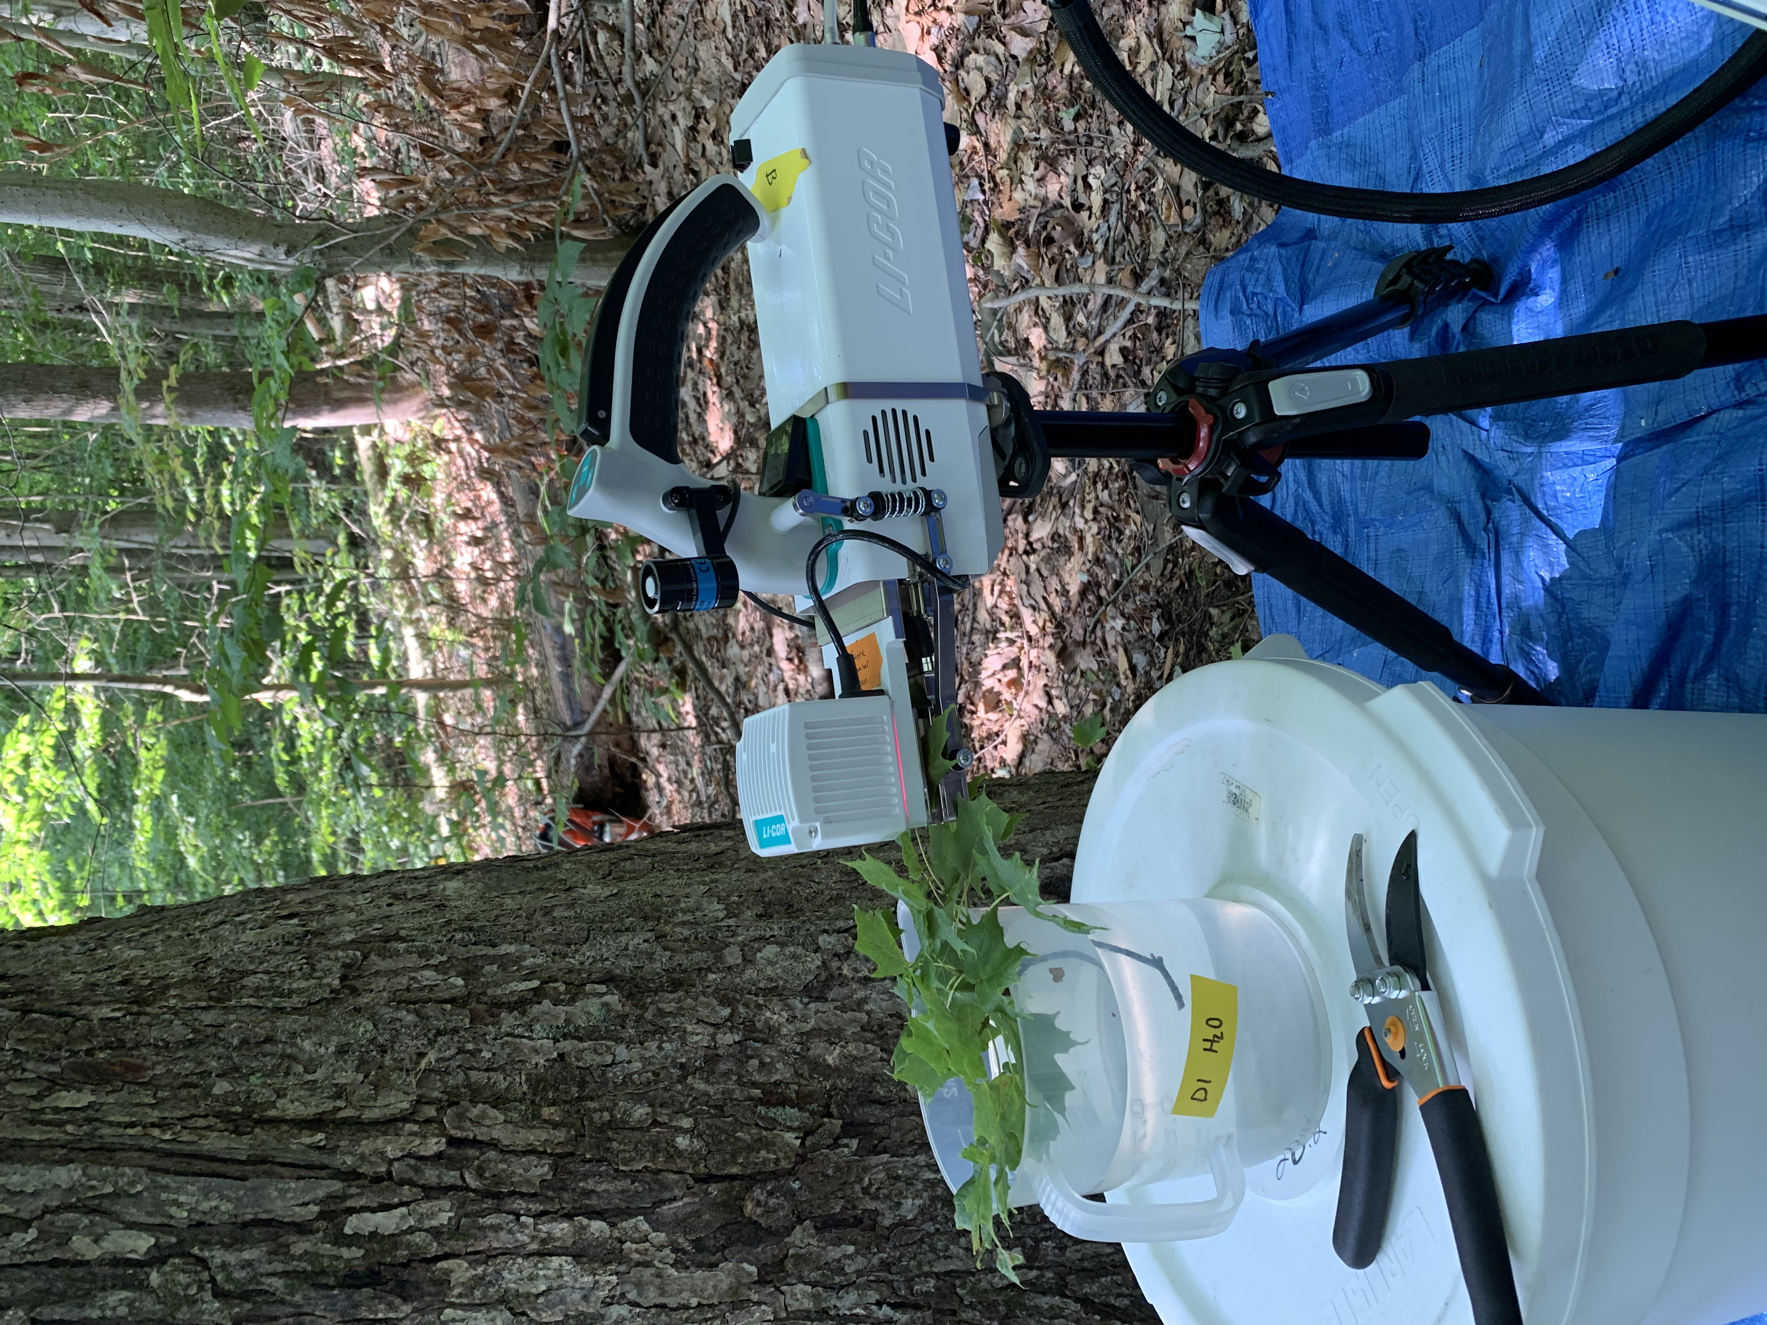
Top canopy leaf measurements
Net photosynthesis and biochemical process rates
Leaf nitrogen per leaf area
PNUE; leaf ¹³C (WUE proxy)
N_{area}:g_{s}; V_{cmax}:g_{s}
Notes:
We measured both leaf and whole plant traits for 6-10 individuals in each plot at each site
We extracted net photosynthesis rate at 400 ppm CO2 and estimated Rubisco carboxylation and RuBP regeneration rates using equations from Farquhar et al. (1980).
We also quantified leaf nitrogen per unit leaf area as leaf nitrogen content divided by specific leaf area.
We then calculated photosynthetic nitrogen use efficiency using leaf nitrogen per leaf area and net photosynthesis
Finally, we measured water-use efficiency using photosynthetic and stomatal conductance data extracted from each carbon dioxide response curve
At the whole plant level, we measured the change in basal area between 2011 and 2019 to get an estimate of woody tissue production and estimated relative growth rate between the same years using allometrically-scaled biomass data

Slide 13
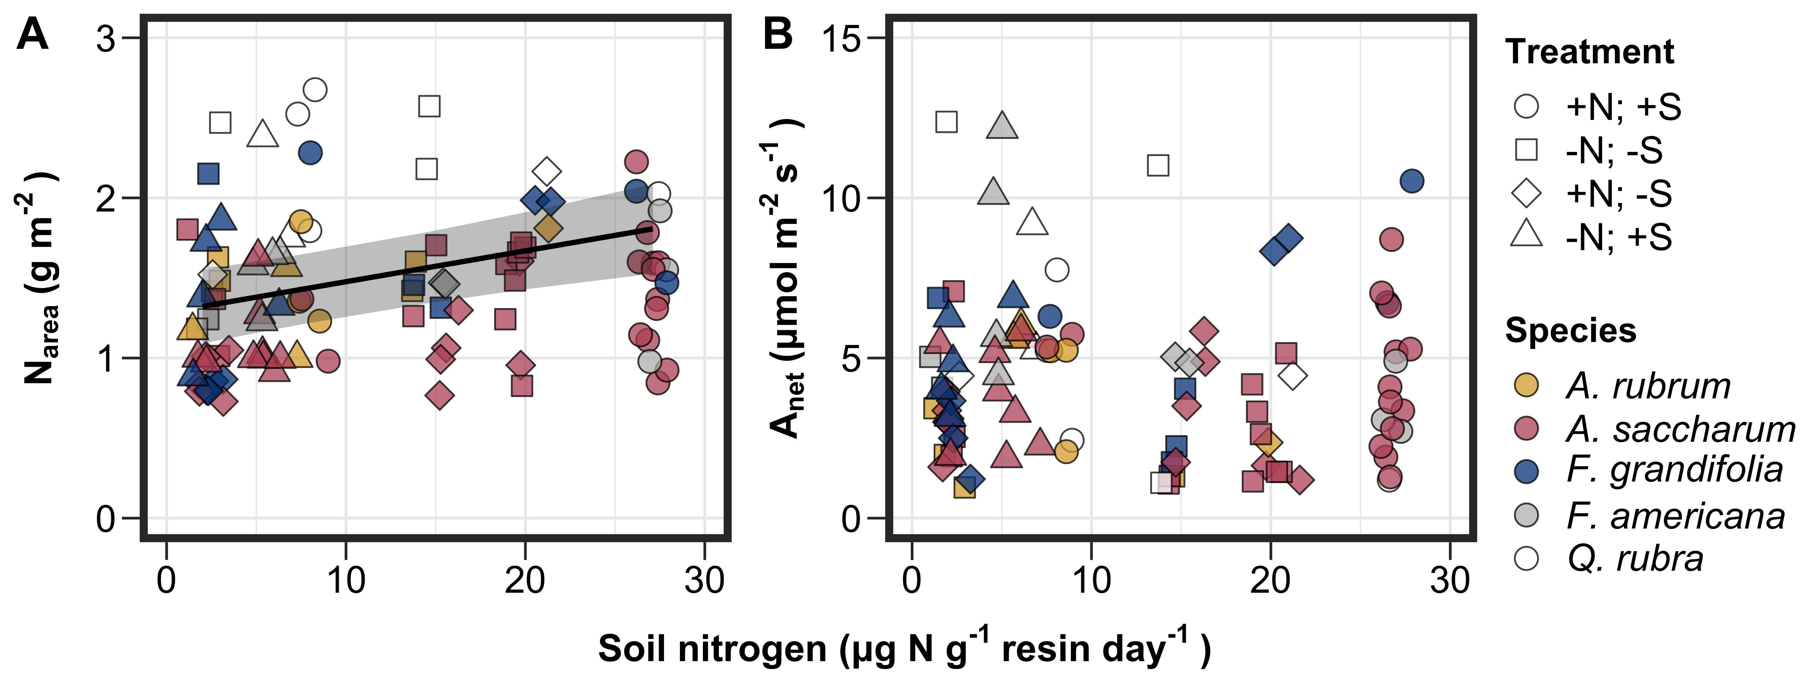
Soil nitrogen availability generally increased leaf nitrogen allocation

Slide 14
Soil nitrogen availability generally increased leaf nitrogen allocation, but not photosynthetic capacity

Slide 15
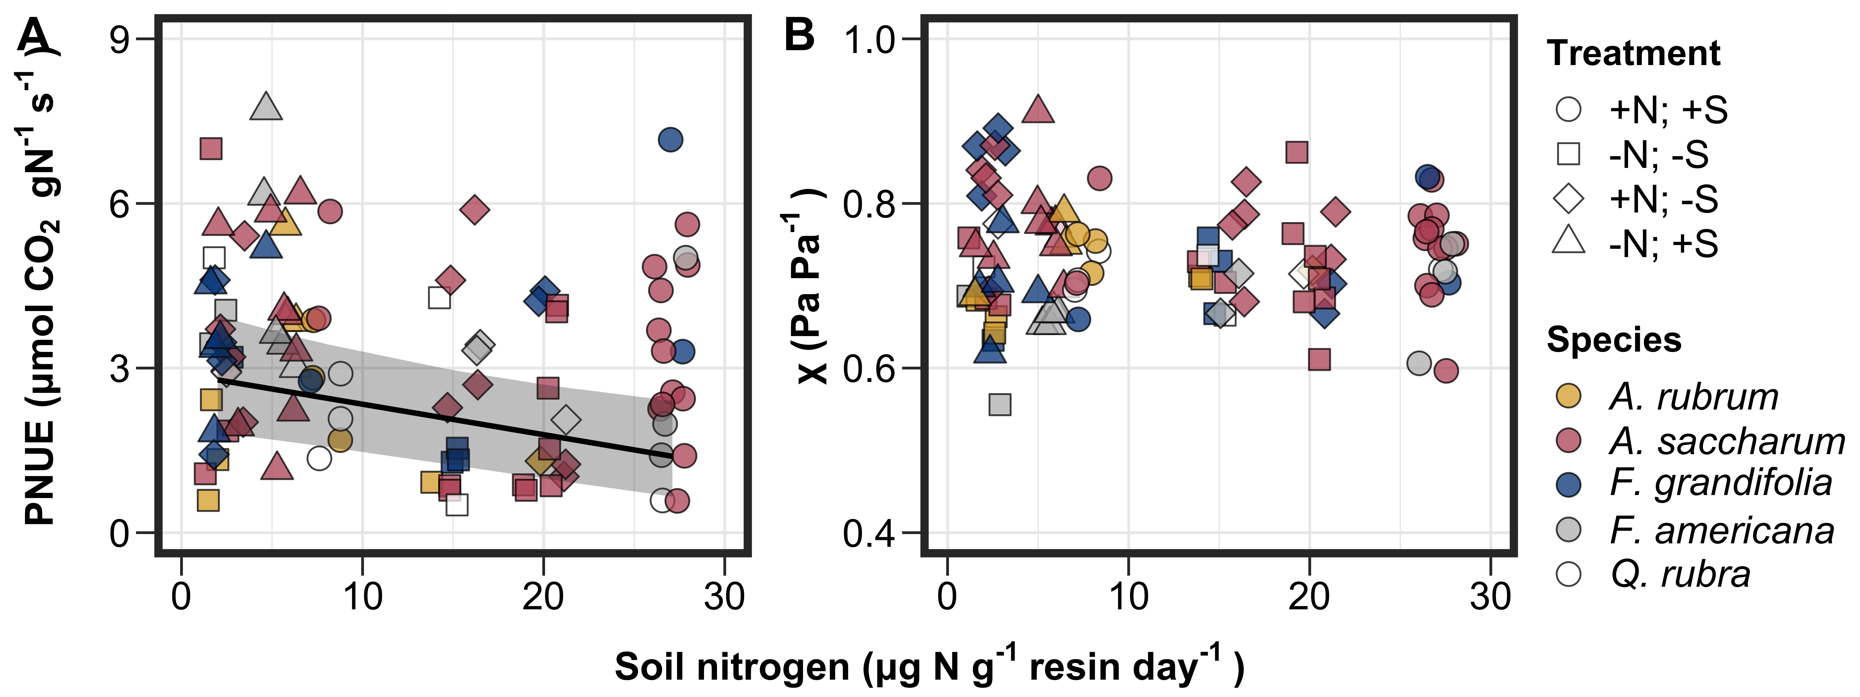
These patterns drove a reduction in photosynthetic nitrogen-use efficiency with increasing soil nitrogen

Slide 16
However, there was no effect of soil nitrogen availability on water-use efficiency

Slide 17
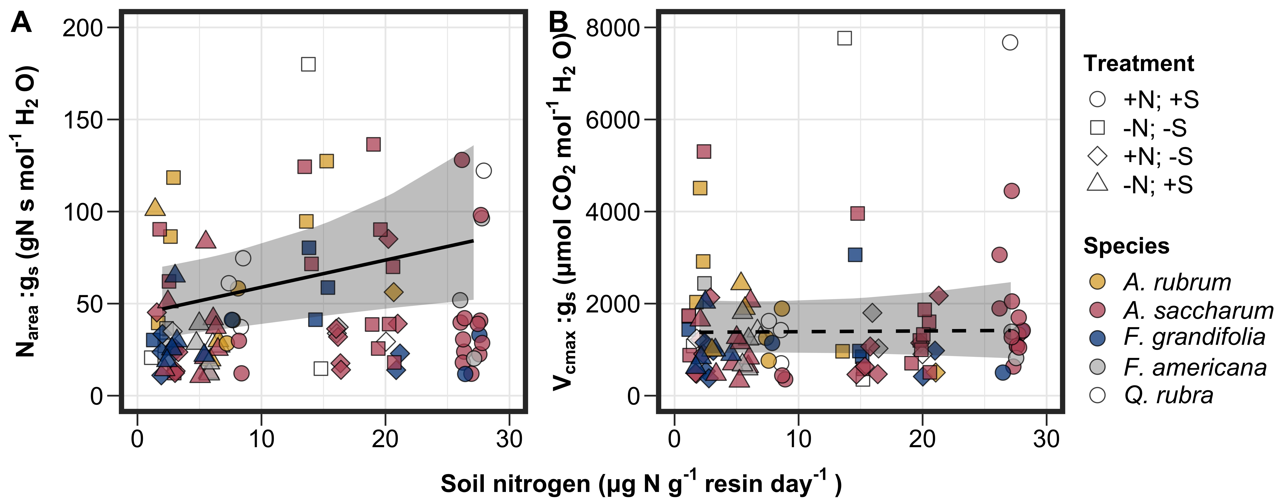
Increasing soil nitrogen availability increased leaf nitrogen allocation per stomatal conductance

Slide 18
Main takeaways
The reduction in leaf nitrogen allocation per stomatal conductance confirmed patterns expected from theory
First to do so in a field manipulation experiment!
The lack of a water-use efficiency response to soil nitrogen was likely driven by lack of water limitation
Increase in leaf nitrogen allocation with increasing soil N a possible bet-hedging strategy?

Slide 19
Acknowledgements
USDA NIFA Award 2015-67003-23485
Risa McNellis (TTU)
Omair Irfan (Cornell)
Romin Abdolahzadi (Cornell)
Schwilk & van Gestel labs (TTU)
Dr. Lizz Waring (TTU)
Dr. John Zak (TTU)
Notes:
Finally, this work could not have been done without the financial support of a USDA NIFA Award and Texas Tech University.
Additionally, I’d like to thank Risa, Omair, and Romin for their help with securing housing and/or assisting with field work.
Finally, I would like to thank members of the Schwilk and van Gestel labs for feedback on data analysis and Dr. Lizz Waring for being a sounding board of my many ideas

Slide 20
Thank you!

